Slide 1
Genome-wide de novo prediction of cis-regulatory binding sites in prokaryotes

Slide 2
Background
There are only a small part of the cis-regulatory binding sites (CRBS) are characterized in E. coli

Slide 3
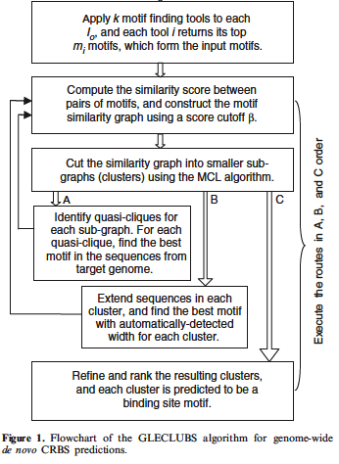
Flowchart

Slide 4
Motif finding programs
MEME
BioProspector

Slide 5
Flowchart

Slide 6
Profile matrix P_{M}
P_{M} = (Prf_{M}(b,i))_{4xL} = (log(p_{M}(b,i)/q(b)))_{4xL}
p_{M}(b,i) = probability of base b appearing at pos I
q(b) = background probability of base b

Slide 7



Self-information
self-information I(ω_{n}) associated with outcome ω_{n} with probability P(ω_{n})
Less likely outcomes will have higher information
Information in a Partitioning C with P(k) being the probability of picking an element in k
Very similar to Entropy = E(I(X))

Slide 8

Information stored in a column of P_{M}
Probability of base b at pos i
Log(p_{M}(b,i)/q(i))
More likely = higher value
Higher I(I,P_{M}) means that we are more confident of the base b at position i

Slide 9
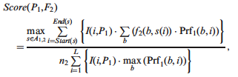
Similarity
Information
frequency
Probability of base b
Select optimal alignment
Upper bound used for normalization

Slide 10
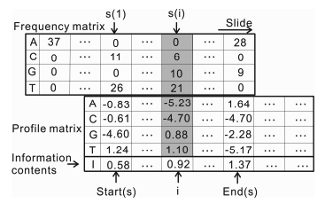
Sliding matrix to find optimal alignment

Slide 11
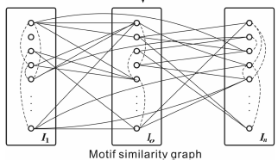
Graph G
I_{o} is set of motifs found given the same starting sequence
Each node is a motif
Each edge connects similar nodes
Edge Weight is motif similarity

Slide 12
Markov clustering algorithm
Van Dongen, S. (2000) Graph Clustering by Flow Simulation PhD Thesis, University of Utrecht, The Netherlands.
Works by using expansion and inflation
Expansion – flow between clusters
Inflation – Strengthens or weakens current cluster
Usually reaches and idempotent matrix
Runs in O(n³) time

Slide 13
MCL pseudocode
G is a graph
add loops to G # see below
set Γ to some value # affects granularity
set M_1 to be the matrix of random walks on G
while (change) {
M_2 = M_1 * M_1 # expansion
M_1 = Γ(M_2) # inflation
change = difference(M_1, M_2)
}
set CLUSTERING as the components of M_1 # see below

Slide 14
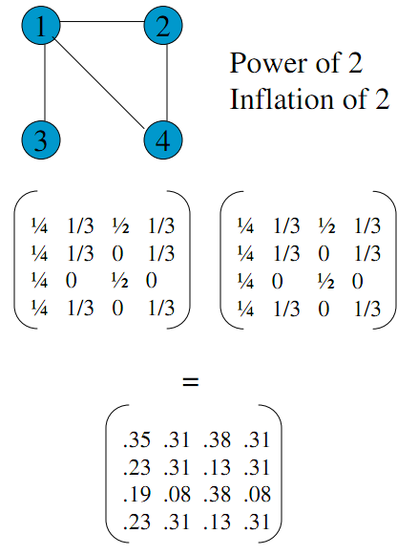
Expansion

Slide 15
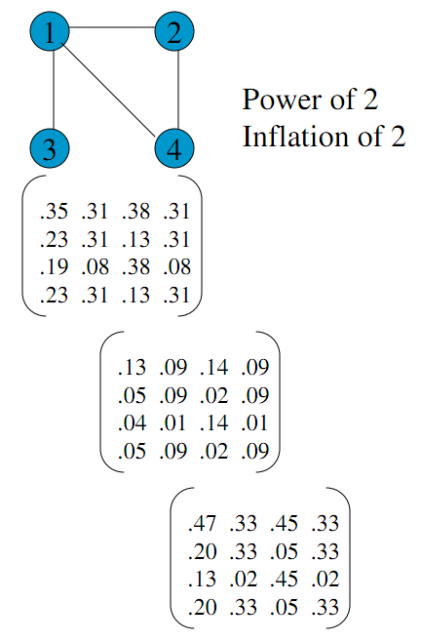
Inflation

Slide 16
Finding cliques
Check each node to see if it belongs to a clique
Apply a greedy approach
Deleting a node on the subgraph with the least # of edges
If there is a tie then delete the least weight of edges

Slide 17
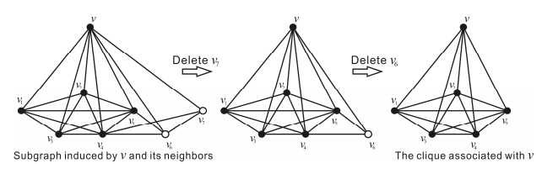
Example of the greedy method to finding a clique

Slide 18

Merge cliques
Merge cliques when ratio of shared nodes is greater than a threshold of:
r_{ab} > .9
R_{ab} > .7

Slide 19

Ranking clusters

